Slide 1
Risky Business?
Allan Johnson
Head of Power Generation
FM Global

Slide 2
Resilience is a choice that…
Matters in any industry, but even more so for yours!
Creates a competitive advantage!
Is achievable!

Slide 3
Power Generation Exposures are Evolving
Transition to Renewable Energy
Changing Operating Profiles
Greater Frequency of Natural Catastrophes

Slide 4
Traditional Power Generation Risks

Slide 5
1
Biggest Losers
2015 – 2020
Gas and Steam
Turbines
$1.4 Billion

Slide 6
Power Generation Portfolio Performance
Multiple losses
- Generators
- Steam Turbines
- Gas Turbines
Boiler Explosion
- Combustion Control Issues
- Poor Operator Response
Steam Turbine Motoring
- Protection System Issues
- Operator Response

Slide 7
Power Generation Equipment Losses

Slide 8
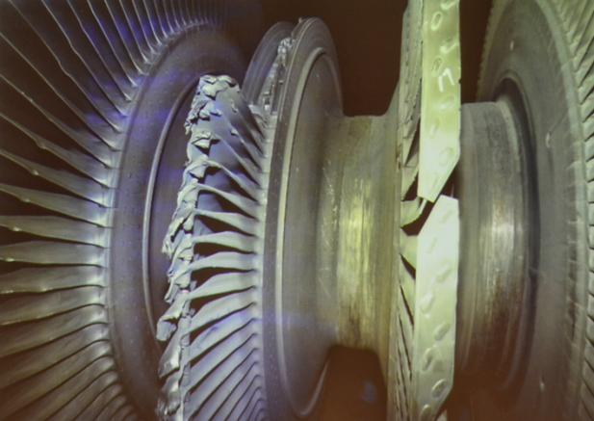
Gas and Steam Turbines
Main Contributing factors:
Inspection & Maintenance
Safety Devices
Operators
Flexible Operations

Slide 9
Evolving Power Generation Risks

Slide 10
Wildfire
Frequency and Severity on the Rise
It’s all about Land Management
Emergency Planning

Slide 11
Solar
Prone to all Natural Catastrophes
High Loss Severity, Low Frequency
Resilient Products
Location selection

Slide 12
Wind Generation
Larger & Larger!
High Loss Frequency, Low Severity
Lightning Protection
Mechanical Damage

Slide 13
Battery Storage Systems
Rapidly evolving technology
Fire Hazard
Battery Management System
Separation

Slide 14
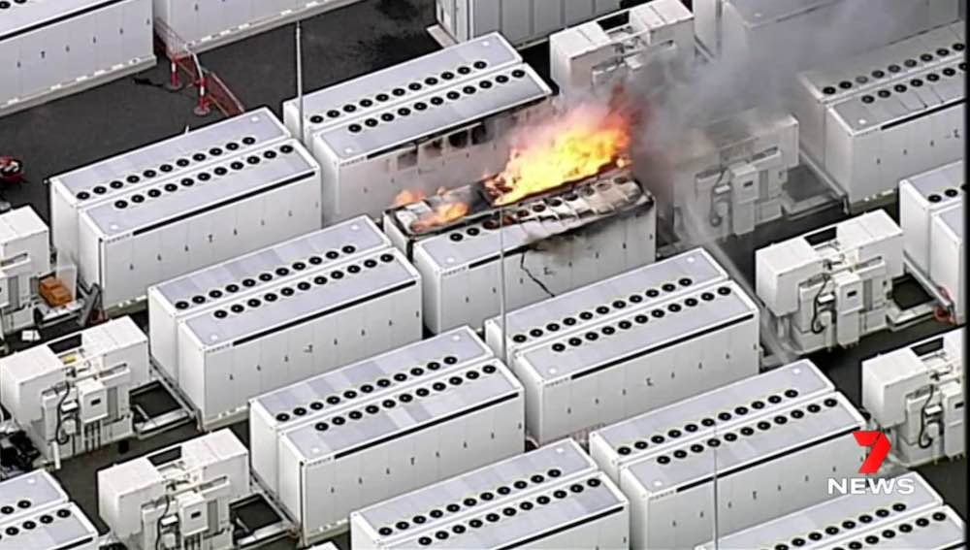
Battery Energy Storage Systems
38 large-scale Li-ion fires since 2018
Reported contributors:
Faulty Installation
Incompatible control systems
Daily deep cycling
Accelerated battery degradation

Slide 15
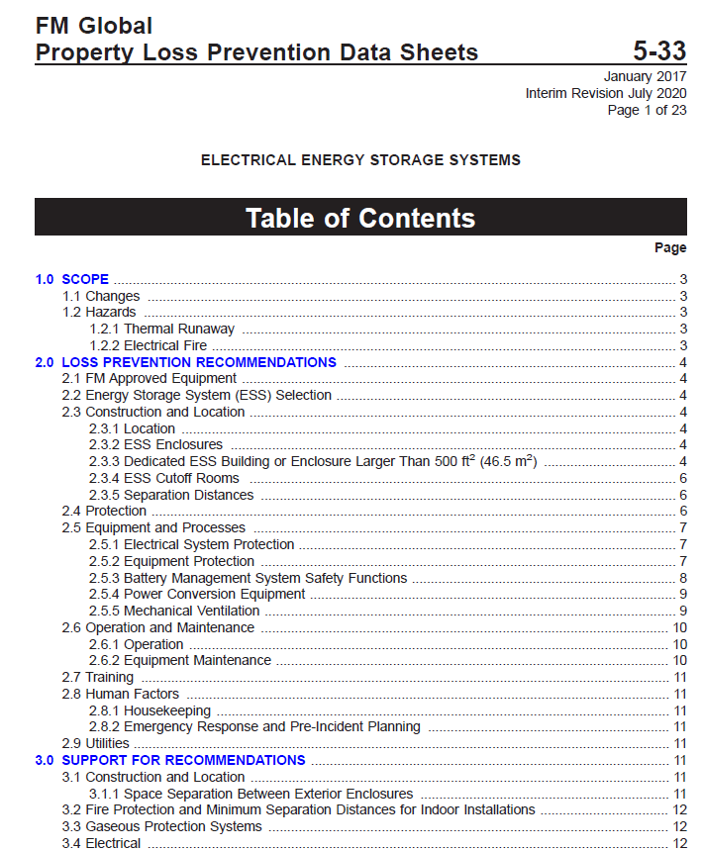
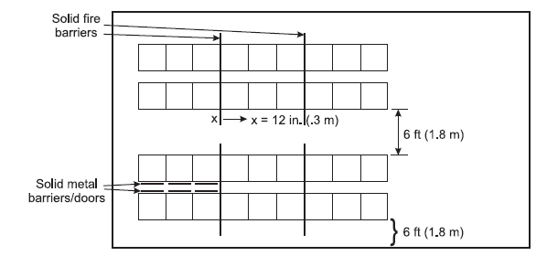
FM Global Data Sheets

Slide 16
Transition to Renewables
Natural Hazards are the Primary Exposures
Build in Resilience during Construction
Location Selection
Equipment Selection

Slide 17
Rising Insurance Costs? Take Control!

Slide 18
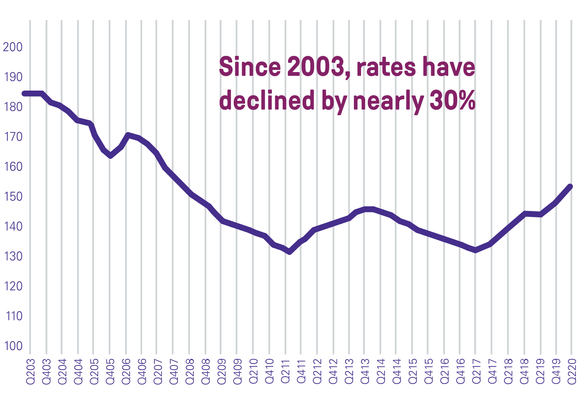
Insurance Rates Bottomed Out
PROLONGED SOFT MARKET
Prior to 2018, rates had been eroding for some time. Commercial property insurance rates have declined by at least 35-40%, along with liberalization of terms and conditions.
Source: CIAB

Slide 19
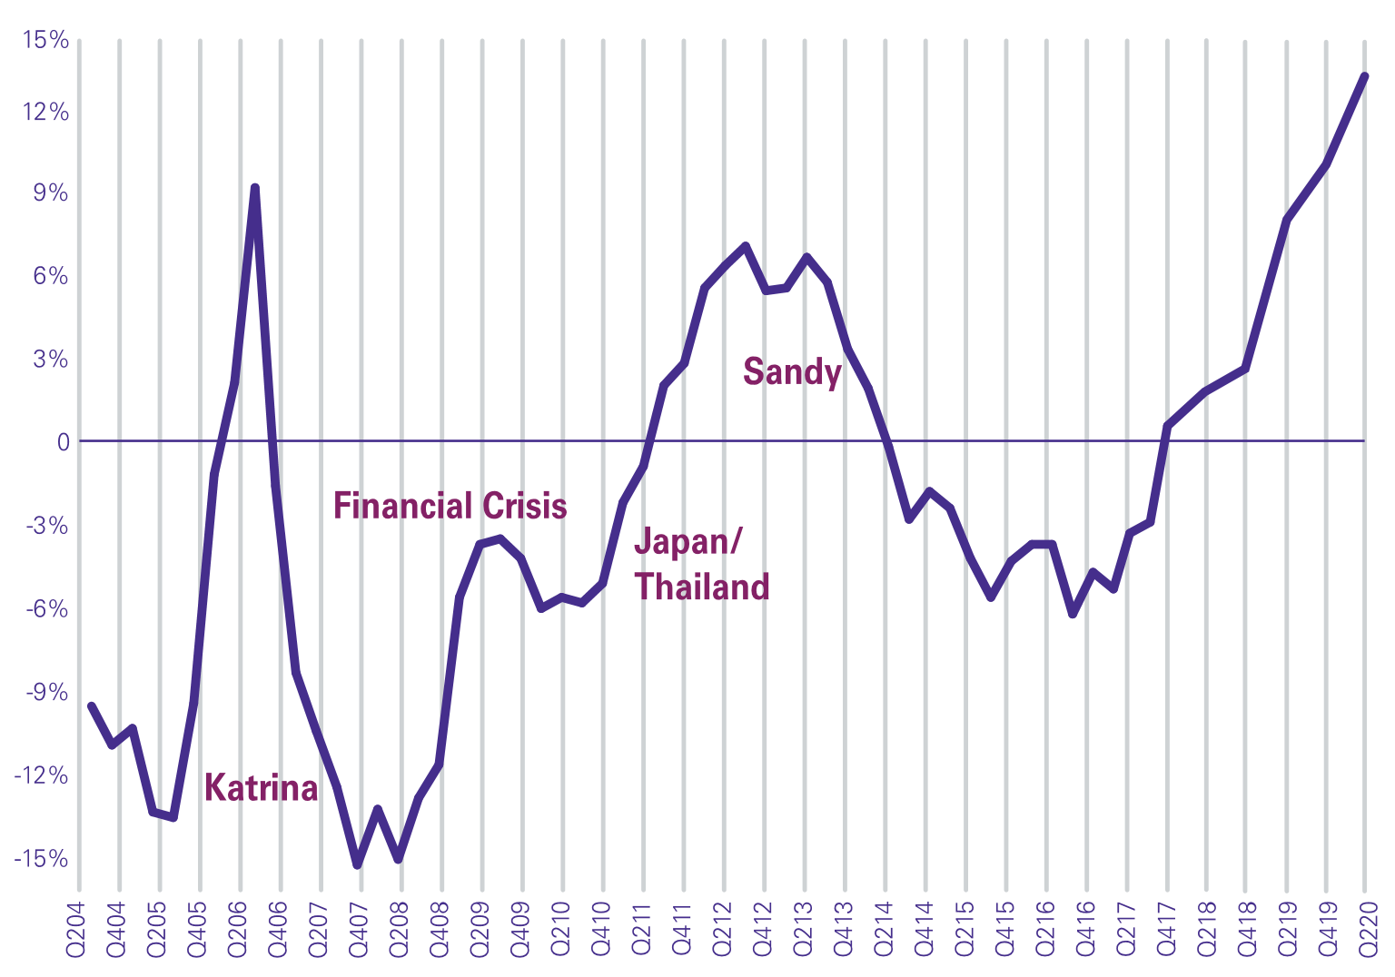
The industry could not cover Losses and Expenses!
RATE TREND
One or two years of rate increases cannot erase a decade of eroding rates, prolonged unprofitability and historically high Nat Cat levels.
Source: CIAB

Slide 20
Resilience is a choice that…
Matters in any industry, but even more so for yours!
Creates a competitive advantage!
Is achievable!

Slide 21
Resilience is a choice that…
Matters in any industry, but even more so for yours!
Creates a competitive advantage!
Is achievable!
Puts you in control!

Slide 22
Insurance alone is not enough!
Insured vs Uninsured 1970-2017
US$ Billion
US $215 billion economic loss
US $68 billion insured loss
Swiss Re: sigma 1/2018

Slide 23
Insurance alone is not enough!
Insured vs Uninsured 1970-2017
US$ Billion
68% uninsured!
US $215 billion economic loss
US $68 billion insured loss
Swiss Re: sigma 1/2018

Slide 24
Take the Driver’s Seat
Invest in Physical Protection to Harden your Facilities
Thorough Testing and Maintenance Programs
Assure Operators are well Trained
Protect against Natural Hazards
Take more skin in the game
Tell Your Story! Early.

Slide 25
The most Important Outcome

Slide 26
The most Important Outcome
The value of your business is protected!

Slide 27
Resilience is your Choice.
Allan Johnson
Head of Power Generation
FM Global

